Slide 1


Basic Data Communication Live Code implementation

Slide 2




Team Member
Harun
221002138
Shipon
221002098

Slide 3

Index
01
Introduction
02
Why we make this?
03
Implementation
04
Future Works

Slide 4

Introduction
Hamming Distance:
Hamming distance is a metric for comparing two binary data strings.
Parity Check:
A parity check refers to an error detection method where an extra bit, or a parity bit, is added to each data unit.
Bit Stuffing:
Bit stuffing is the mechanism of inserting one or more non-information bits into a message to be transmitted, to break up the message sequence, for synchronization purpose.
Character Stuffing:
Character stuffing is a technique used in computer programming to control data transmission between different systems or devices.

Slide 5

Why we make this?
Because of enriching the core concept of Data communication which we learn in this semester. We have learn encoding, hamming code, parity check, bit & character stuffing & destuffing and now we want to apply that concept in our code that’s why we choose this projects.

Slide 6
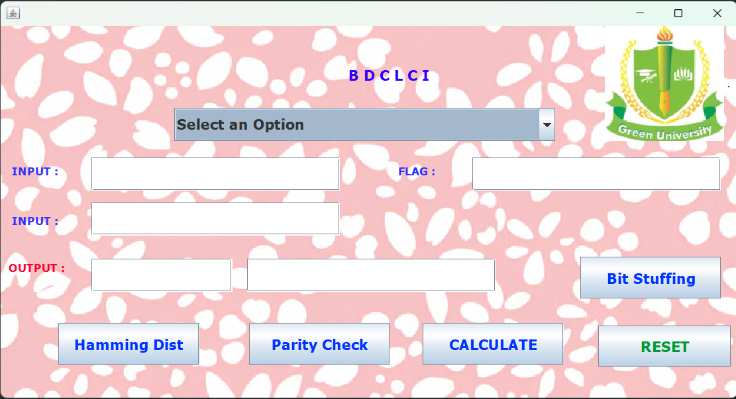
Implemantation

Slide 7
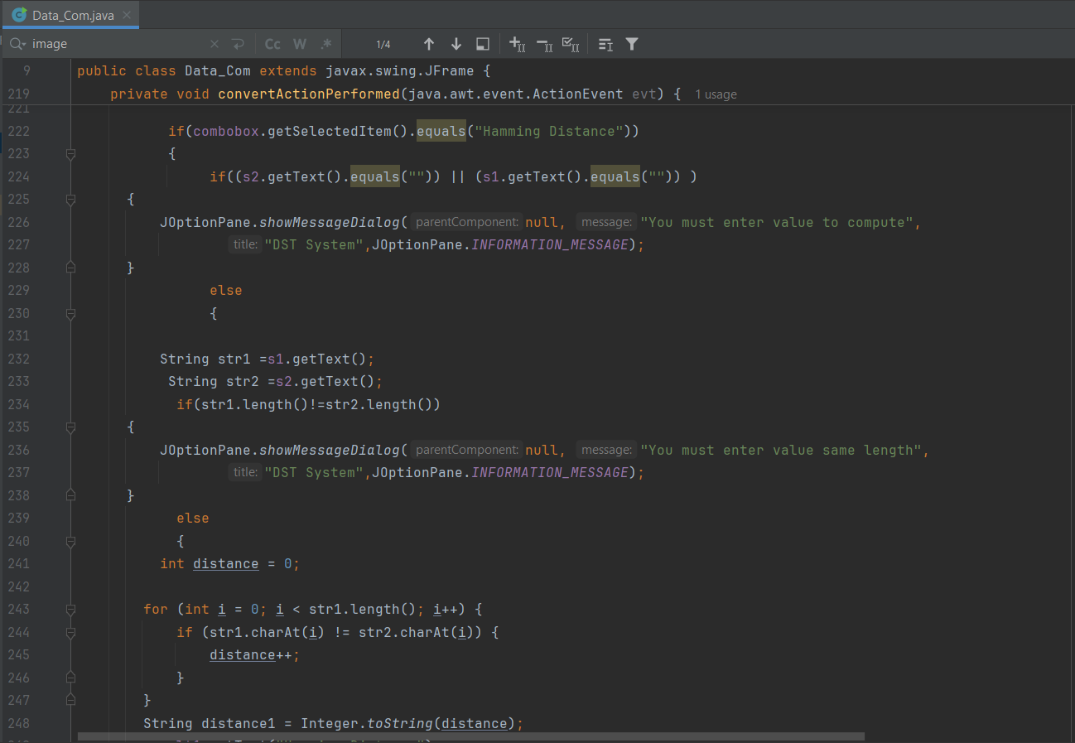
Code

Slide 8

Future Work
Character Destuffing Implementation: Completing the functionality for character destuffing to provide a comprehensive set of tools for both stuffing and destuffing processes.
Enhanced Error Handling: Improving input validation and error messages to guide users more effectively.
Additional Communication Techniques: Introducing more advanced data communication methods, such as cyclic redundancy check (CRC) or forward error correction (FEC).
User Interface Enhancements: Refining the GUI for better usability and visual appeal, possibly including graphical representations of the data transformation processes.

Slide 9


